Slide 1

Please follow Presentation Instructions:
Slide 1: Cover
Project Title: [Project Title]
Presenter's Name: [Your Name]
Date: [Date of Presentation]
Slide 2: Project Idea
Brief description of the problem being solved
Overview of the proposed solution (high-level idea)
Unique value proposition (Explain what makes your project stand out)
Slide3: Project Wireframe
Visual representation of key user interfaces (e.g., homepage, dashboard)
Overview of user journey (from onboarding to core features) | *Note: for software groups only
Focus on usability and user experience

Slide 2
Please follow Presentation Instructions:
Slide 4: End Users + Features
Define primary user personas (e.g., individuals, businesses, etc.)
Key features that address user needs (list the most critical functionalities)
Explain how the features solve the problems of each end-user
Slide 5: Data Structure
Description of the database architecture (e.g., relational, non-relational)
Key entities and relationships between data points
Data flow (how data is collected, stored, and accessed). *Note: If you used CSV file, describe the features, the shape of data, balanced or not, used techniques, etc..
Final 6: Programming Languages + Frameworks
List the main programming languages used (e.g., Python, JavaScript)
Highlight frameworks/tools used (e.g., Django, React)
Mention any supporting technologies (e.g., APIs, cloud platforms)

Slide 3
Please follow Presentation Instructions:
Slide 7: Live Application + Test
Overview of the current state of the live application (beta/production)
Key testing phases (unit testing, integration testing, user testing)
Feedback from users or quality assurance
Slide 8: Deliverables (Reports, etc.)
List of reports and documentation to be provided (e.g., technical specs, user manuals)
Timeline for deliverables (milestones and deadlines)
Other final products (e.g., working app, source code repository)
Slide 9: Project Team + Roles
List the core team members and their roles (e.g., developers, UX designers)
Key responsibilities for each team member
Collaboration methods (e.g., communication tools, agile methodologies)

Slide 4
Please follow Presentation Instructions:
Slide 10: Thank You
Contact information for follow-up
Invitation for questions or feedback

Slide 5

MANDATORY Color Scheme
Note: This is the official
color scheme for DEPI
Feel free To use it
#047954
#0FAB7D
#336EA8
#D7B119

Slide 6
Hyper Tech – Data Analytics & Business Intelligence Project
Maged Magdy Nageeb Elias

Slide 7


Problem: Hyper Tech had no analytical system to monitor sales, customers, products, or returns.
Solution: Build a complete BI solution using a structured data model + interactive dashboards.
Unique Value: Multi-platform dashboards (Power BI + Tableau), star schema, and full data transformation pipeline.

Slide 8
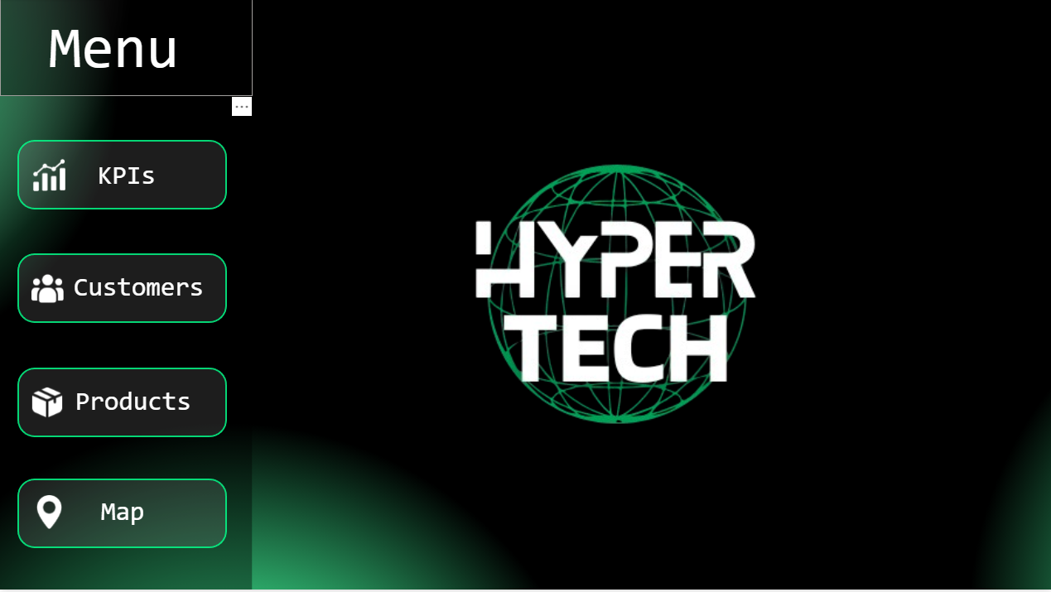

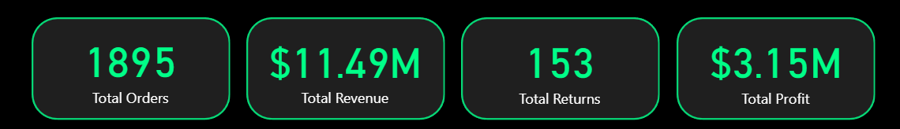
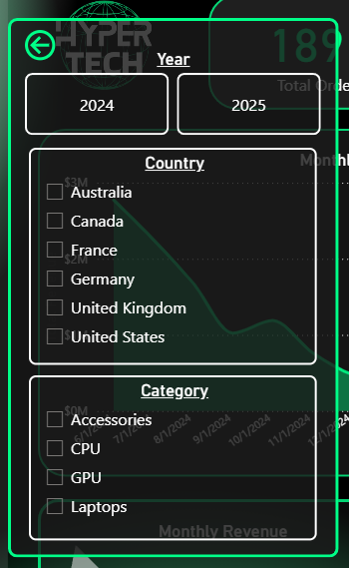
The dashboard uses a clean navigation flow: Menu → KPIs → Customers → Products → Map
→
→
With dark neon theme for readability and brand consistency
→
There is many important KPIs as:
Total Orders, Total Revenue, Total Returns and Total Profit.
→
Filter popup provides flexible control (Year, Country, Category)

Slide 9
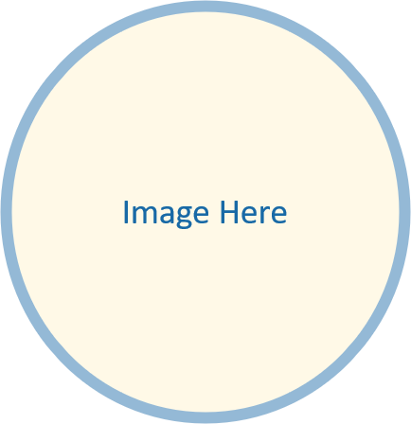
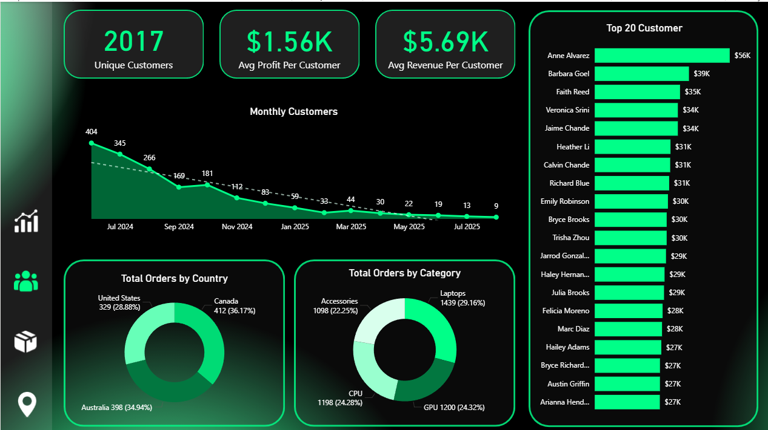
End Users: Hyper Tech Store Owner
→
→
Main Features:
- KPI Insights
- Customers Analysis
- Product Performance
- Brand Performance
- Geographical Map
- Filter Popup
- Multi-Page Navigation
→
How Features Solve Problems:
Identify weak products, high returns, customer behavior, regional trends

Slide 10
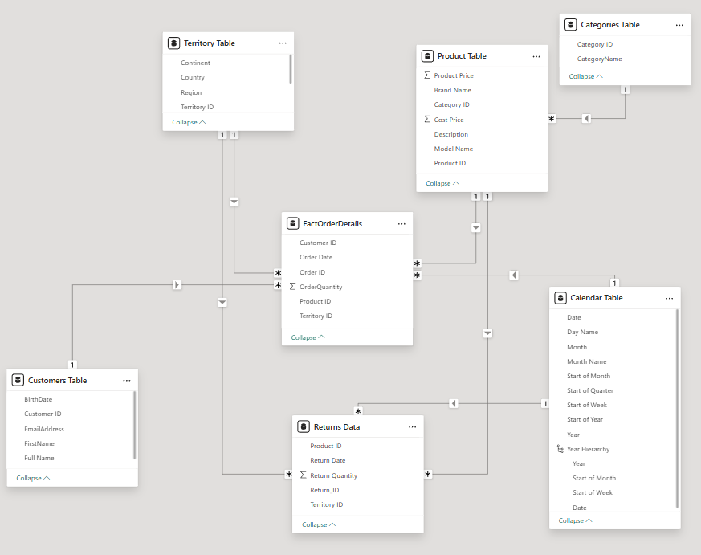
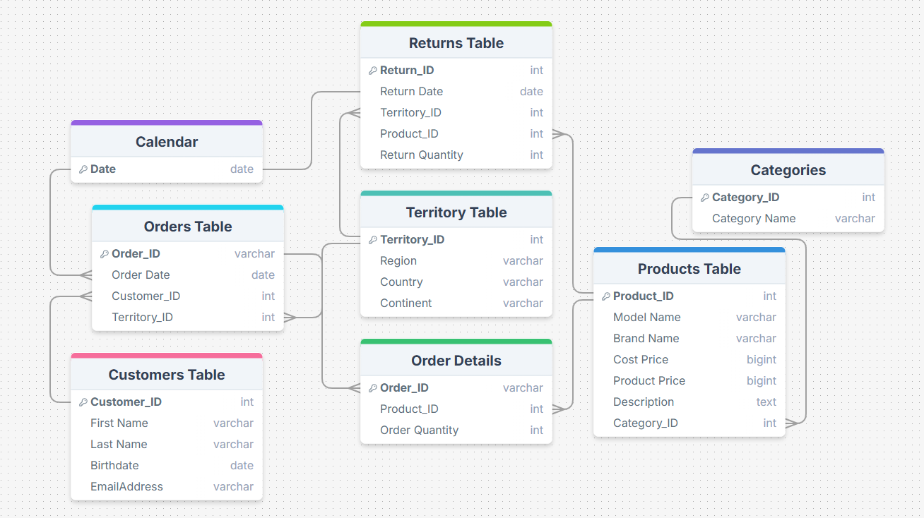
Data Warehouse uses a Star Schema
→
→
Fact Table: FacrOrderDetails
→
Dimensions: Customers, Products, Categories, Territory, Calendar, Returns
Data Flow: CSV → Cleaning (Power Query + SQL) → Modeling → Dashboards

Slide 11
Programming Languages & Tools
SQL: transformations, joins, cleaning
Power Query: calculated columns, data shaping
DAX: KPI measures, time intelligence, targets
Power BI Desktop + Service: main dashboard
Tableau: summary dashboard
Other Tools: Canva, Flaticon icons, Draw.io

Slide 12
→
Click Here To Open Live Project Link
Milestones & Deadlines
Week 1: Data Collection
Description: Gathered all raw data related to products, orders, and customers from available sources. Ensured completeness and initial understanding of the dataset.
Week 2: Data Cleaning Phase 1, Preparation, Database Design, Modelling, Data Warehouse Concept applied
Description: Cleaned and organized the collected data to ensure accuracy and consistency. Designed the Entity Relationship Diagram (ERD) and database schema, then converted the database into a data warehouse structure by dividing it into fact and dimension tables to support analytical queries and performance optimization.
Week 3: Exploratory Data Analysis (EDA), Advanced Analysis & Insights Extraction
Description: Conducted exploratory and advanced analysis to uncover deep insights about product sales, customer segments, and profitability patterns. Applied advanced analytical techniques such as correlation analysis and performance comparison to identify key business drivers and opportunities for profit growth.
Week 4: Visualization and Dashboard Development (Phase 1)
Description: After making a revision on the cleaned data and managed to complete the cleaning process on “Power Query Editor” , we made a chart for each question to answer it (story telling technique) by making a measure for each insight and use these measures in the charts to show important data and answer the questions, also we planned the ideas of the structure of pages of the dashboard layout and implement the overall dashboard design.
Week 5: Visualization Refinement and Report Writing (Phase 2)
Description: Finalized all dashboards and visualizations, documented detailed findings, and prepared a comprehensive report summarizing insights and business recommendations.
Week 6: Final Presentation and project Delivery
Description: Presented the final project, including all analytical outputs, dashboards, and insights, SQL Queries Report Sheets, demonstrating how the analysis supports higher profit, efficiency, and smarter business decisions.

Slide 13
Maged Magdy (Team Leader):
Led the full project lifecycle from data collection to dashboard deployment. Designed the overall UI/UX theme, color palette, and visual identity at the start. Built the Menu page, added all navigation buttons, selections, and bookmarks, and ensured consistent formatting across all pages. Reviewed and refined each team member’s work, guaranteeing quality, accuracy, and style alignment before merging everything into one unified, professional dashboard.
Ibrahim
Contributed to data cleaning and analytical exploration. Provided key insights from EDA and product-profitability analysis. Developed the KPIs page in the dashboard, turning essential performance metrics into clear, interactive visuals.
Ahmed
Managed data collection and validation, ensuring the initial datasets were correct and ready for modeling. Provided continuous support in visualization and problem-solving. Developed the Customers page, focusing on customer segmentation and behavioral insights.
Marly
Led SQL-based data cleaning and ensured dataset accuracy. Supported model refinement and visual reviews. Developed the Products page, delivering detailed analysis of product performance and category trends.
Shehab
Specialized in data modeling and DAX development. Created essential measures and logic for accurate KPIs and analysis. Developed the Map page, presenting geographic performance insights across regions.
Ali
Provided consistent support in data validation, quality checking, and early issue detection. Assisted in reviewing and merging dashboard pages to ensure accuracy and completeness in the final report.

Slide 14
Thank You
→
Gmail: magedelias53@gmail.com
Phone: +20 1224637404

